Slide 1
The Inspection Process

Slide 2
References
Boehm, Barry W., “Software Engineering Economics”, Prentice-Hall, 1981
Dyer, Michael, “The Cleanroom Approach to Quality Software Development”, Wiley, 1992
Fagan, Michael E., “Design and Code Inspections to Reduce Errors in Program Development”, IBM Systems J., Vol 15, No 3, 1976
Freedman, Daniel and Gerald Weinberg, “Handbook of Walkthroughs, Inspections and Technical Reviews,” 3rd Ed Little, Brown, 1982
Gilb, Tom and Dorothy Graham, “Software Inspection”, Addison-Wesley, 1993
Parnas, David L. and David M. Weiss, “Active Design Reviews: Principles and Practices”, Proc. Eighth International Conference on Software Engineering, 1985
Waldenstein, N.S., “The Walk-Thru-A Method of Specification, Design, and Review”, Technical Report, Number 00.2436, IBM Corp., 1976
Wheeler, David A., Bill Brykczynski and Reginald Meeson, “Software Inspection: An Industry Best Practice”, IEEE, 1996
http://www.ics.hawaii.edu/~johnson/FTR/ - “The WWW Formal Technical Review Archive”
Notes:
2

Slide 3
Introduction
Basics of Fagan's inspection method
  developed at IBM
  had to contribute to net profit to survive
Ensures project documentation is
  clear, self-explanatory
  unambiguous
  consistent with other documentation and goals

Slide 4
Inspection Objectives
Promote completeness and correctness of product
Promote adherence to project style and rules of construction
Promote compliance with technology practices in organization
Provide advocacy for multiple views of the system
Obtain metrics for project management and process improvement

Slide 5
Economics of Inspection
Catches errors early
Testing is 50-55% effective in removing defects
Inspection is about 80% effective
Inspection can operate on specifications
  defects 10x100 times cheaper to fix then
Average five hours saved for every one hour of inspection

Slide 6
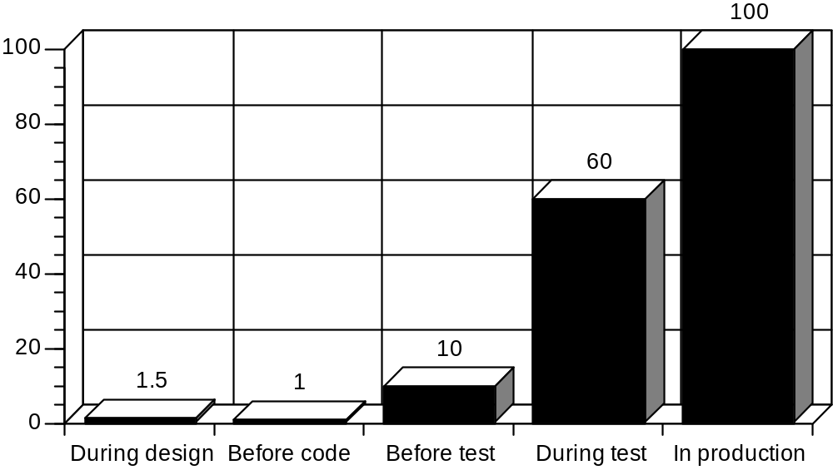
Relative Costs to Fix Defects

Slide 7
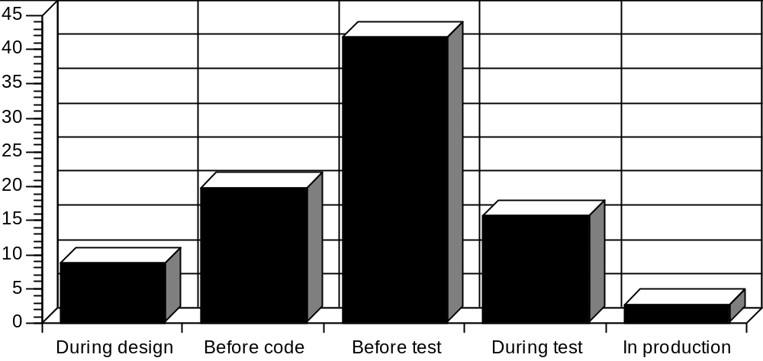
Errors Found With Inspection

Slide 8
Experience Data
IBM Federal Systems Division [Gilb 93]
  300 SLOC/MM for 30 Inspection-managed projects
  144 SLOC/MM for 30 Structured Walkthrough projects
ICI maintenance costs [reported in Gilb 93]
  0.6-0.7 min./SLOC/year in 400 programs developed with inspections
  7 min./SLOC/year in similar number developed without inspections
Notes:
06/10/98
48

Slide 9
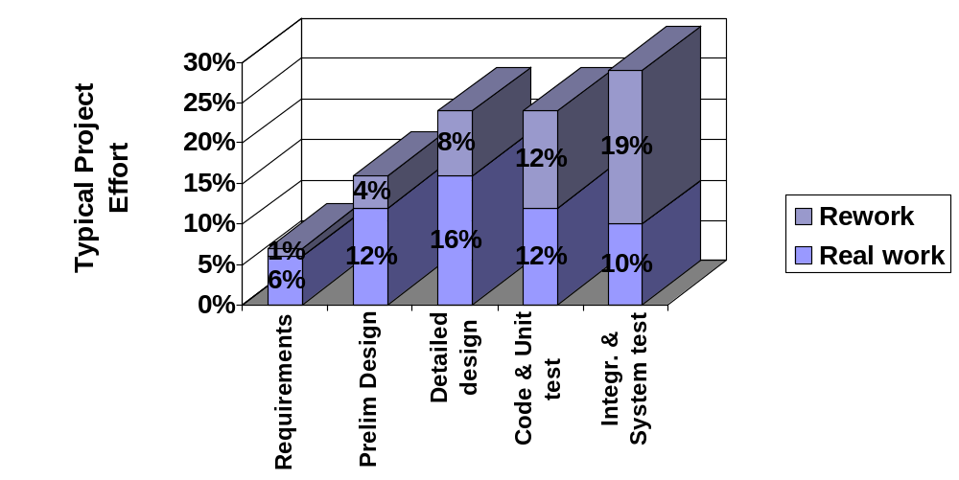
Why Inspection Reduces Cost
Notes:
06/10/98
49
From Wheeler 97, supposedly derived from Boehm 81.
Note - Capers Jones claims that s/w costs are mainly (a) defect removal (b) documentation.
NCC UK quote - The cost of non-quality s/w typically accounts for 30% of dev costs & 50-60% of lifecycle costs.

Slide 10
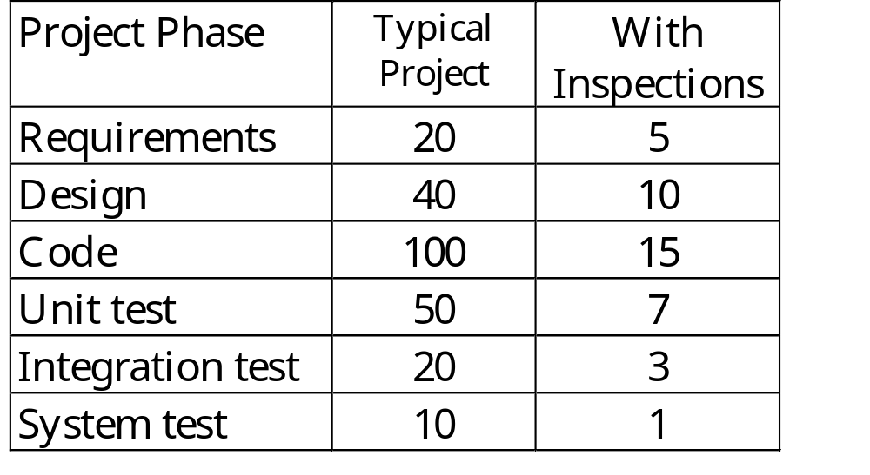
Defects Passed from Phase to Phase [Wheeler 97]
Notes:
06/10/98
50

Slide 11
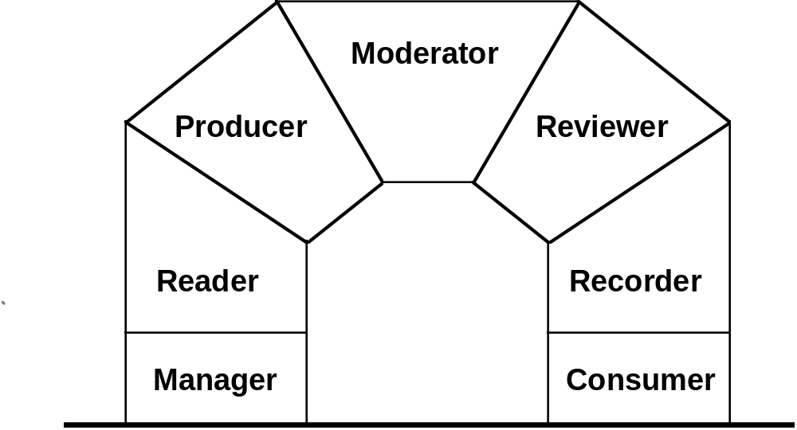
Roles

Slide 12
Basic Rules
Carried out at several times in project lifecycle
All classes of document defects inspected
Carried out by all levels of project
Follow prescribed series of steps
Meetings limited to two hours
Led by trained moderator
Inspectors assigned specific roles
Checklists used to define task
Material inspected at optimal rate
Statistics on defect types kept

Slide 13
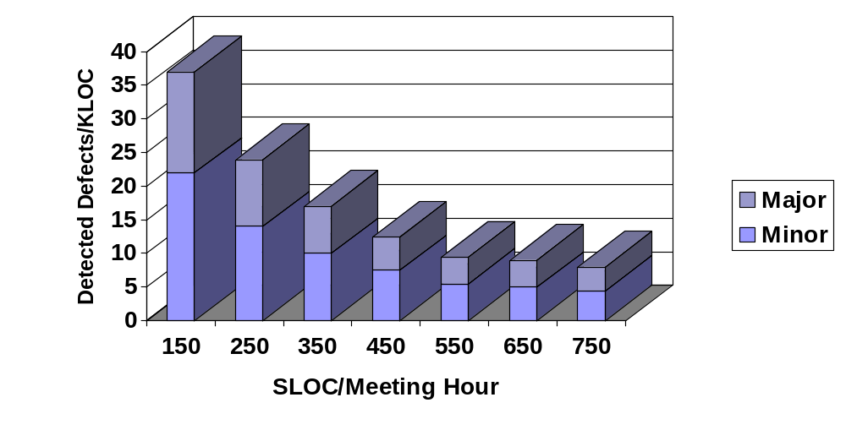
Inspection Rate Impact (BNR)
Notes:
06/10/98
51

Slide 14
Rate of Inspection
Studies have shown rate effects errors found
Too fast or too slow decreases efficiency
Keep statistics on defect-finding efficiency to find optimal rate
Train moderators to keep to optimal inspection rate
Around 70-122 noncomment source lines per hour for code

Slide 15
The Trained Moderator
Organizes meeting, materials
Leads inspection meeting
Ensures participants follow procedural rules
Paces the inspection process at productive speed
Notes and classifies defects
Assigns defect list to individual for rework
Checks that assigned rework has been done and passed

Slide 16
Inspection Steps
Planning
Overview
Preparation
Meeting
Rework
Follow up
Third hour meeting

Slide 17
Planning
Done by moderator
Assess product readiness for inspection
Obtain reviewers, reader, recorder and brief on their roles
  inspectors should be from other teams than authors
Verify checklists are complete
Schedule meetings
Distribute documentation to inspectors

Slide 18
Overview
Presentation
Gives inspectors project overview
30-60 minutes
Can be omitted if inspectors familiar with project

Slide 19
Preparation
Inspectors spend about 1 1/2 hours prior to meeting
Familiarize selves with material
Attempt to find maximum number apparent defects
  inconsistencies between documentation sets
Advanced preparation increases meeting productivity

Slide 20
Meeting Entry Criteria
Checked by moderator
Assess whether trained and briefed participants are in place
Ensure participants have reviewed product and checklists
Learn preparation time of participants
Identify any changes to baseline

Slide 21
Meeting
Attended by all inspectors, including moderator
Three to five participants, normally
Maximum two hours long
Originators of documentation not all present
Go through conduct checklists
Inspectors point out suspected defects
Moderator notes defects in writing
Identify issues, not proposed solutions

Slide 22
Classification of Defects During Inspections
It is a good idea to categorize defects during inspections.
  (a) to find out how effective the inspections really are
  (b) to determine the type and severity of errors that are working their way into the software
  (c) to help to identify error-prone modules
  (d) to facilitate trend analysis
Minimally you should categorize by: defect scope, defect type, defect severity

Slide 23
Recording Times Spent Reviewing
In addition to defect lists and defect categories you should also record data about review times
  How long was spent in document inspection prior to the meeting?
  How much time was spent in the inspection meeting?
  How much time was spent removing the defects after the inspection?
This will allow you to calibrate review teams and to refine estimates of review times
It also will facilitate cost/benefit analyses for inspections

Slide 24
Meeting Exit Criteria
Have all product elements been inspected?
Have all checklists been processed
Have the inspection results been recorded?
Has the producer been given the opportunity to record comments?

Slide 25
Rework
Defects assigned to one person to repair
Resolve all issues raised in inspection according to resolution types
Note completed actions in Software Notebook
Rework happens outside the meeting

Slide 26
Follow Up
Moderator verifies defects are reworked
Otherwise, document is not useable
Moderator not required to judge correctness
Correctness of rework process subject to later inspections and tests

Slide 27
Third Hour Meeting
Held if desired
Venue for inspectors to offer solutions or improvements
Ensures good solution ideas not lost

Slide 28
Roles (Reminder)

Slide 29
Manager
Plans and schedules all software inspections
Assigns resources
Ensures moderators are trained
Receives reports of results and manages follow-up actions
Does not attend software inspection

Slide 30
Producer
Produces materials
Attends inspection as reviewer and raises issues
Provides technical explanation as appropriate
Does not defend product

Slide 31
Moderator
Directs software inspection preparation activity
Briefs participants
Directs entry criteria
Directs conduct of inspection
Directs exit criteria
Reports to management

Slide 32
Recorder
Records preparation time of participants
Records issues and concerns
For each issue, records
  issue
  product element
  checklist and entry
  defect and resolution attributes

Slide 33
Reader
Paces the review by paraphrasing the artifact under review
Ensures at least one person other than the author can understand it
Paraphrases a bit, then pauses for reviewers to offer defects

Slide 34
Reviewer
Raises issues and concerns
Provides feedback on issues raised

Slide 35
Consumer
May receive inspection report as acquisition agent

Slide 36
Benefits of Inspection
Cost savings
Sets standard of excellence
Fosters discipline in organization
Control over schedule
Reduced maintenance costs
Increase in correctness
Reduction in test effort

Slide 37
Cost Of Inspections
Design and code inspections are expensive! (But they are cheaper than no inspections.)
In design and coding phases of the life cycle, they account for as much as 25% of the effort.
A typical figure would be about 10% to 15% of engineering effort is spent on inspections in the design and coding phases.

Slide 38
How Effective Are Inspections?
Inspections are probably the most effective form of verification and validation, surpassing even testing in ability to detect defects.
A previous article illustrates the value of reviews:
R.W. Selby and V.R. Basili, "Analyzing Error-prone System Structure," IEEE Transactions on Software Engineering, Vol. 17, No. 2, February 1991.
Many other references confirm this. Another good source is T. Capers Jones, Programming Productivity, and his seminar notes from "Optimizing Programmer Productivity and Quality."

Slide 39
Example Project Profile
In the Selby & Basili article, the project profile was:
  148 KLOC overall
  40 KLOC new code
  16 month duration
  25 staff members at peak
  170 inspections conducted
  770 defects discovered in inspections
  54 defects discovered in testing
  --- Overall project effort was not reported

Slide 40
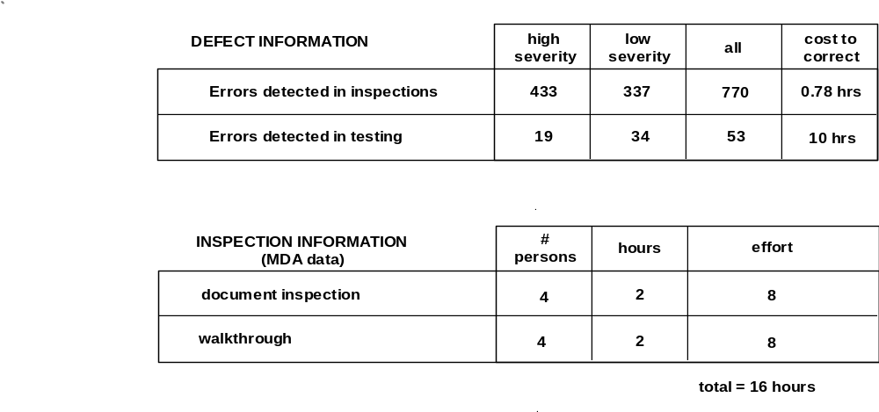
Cost of Defect Removal

Slide 41
Cost of Inspections
Cost of holding inspections =
  170 inspections * 16 hrs/insp = 2,720 person hours
Cost of removal of errors discovered at inspections =
  770 defects * 0.78 hrs/defect = 601 person hours
Total Cost =
  3,321 person hours = 415 person days

Slide 42
Cost of NO Inspections
Cost of isolation & removal of deferred defects =
  770 defects * 10 hrs/defect = 7,700 person hours
      = 962 person days
Difference in costs =
  962 person days - 415 person days
  = 547 person days (cheaper with inspections)
Cost could in fact be higher than this because
  assumed that all 770 would be caught at test
  inspections detected more severe errors by %

Slide 43
Planning for the Cost of Inspections
The cost of reviews is very high, but it is also obviously cost-effective
If you plan to hold reviews the cost will be easier to handle. If you don't plan on it, the cost will be a burden and reviews may not be held because there isn't any time
As a rule of thumb, 15% to 25% of every engineering work package in the requirements, design and code phases should be allocated to reviews and inspections
Make the cost explicit in the work package description

Slide 44
Inspections Conclusion
The cost of not doing inspections is much higher than the cost of doing inspections.
However, this is only going to be true if the inspections are effective:
  they do discover defects
  don't use unnecessary time

